Slide 1
ATM Project using Spring Framework
Fresher Java K30_ Mock project

Slide 2
Agenda
About team
Validation
Withdraw
1
2
3
4
5
6
Overview
Check balance
Conclusion

Slide 3




Our team
Lê Văn Phú
PhuLV1
DNU
Phan Xuân Mạnh
ManhPX1
HCMUAF
Trần Anh Quân
QuanTA5
UIT
Mai Văn Hải
HaiMV
HCMUAF

Slide 4
Overview
About project
Object:
-Build an ATM simulator application
-Understand software development process, MVC architecture
-Study new technology
Technology:
-Spring MVC
-Hibernate
-MySql database
-Java script, ajax, bootstrap
Tools:
-Spring Tool Suite
-XAMP
-Tortoise SVN

Slide 5
Overview
Use case diagram

Slide 6
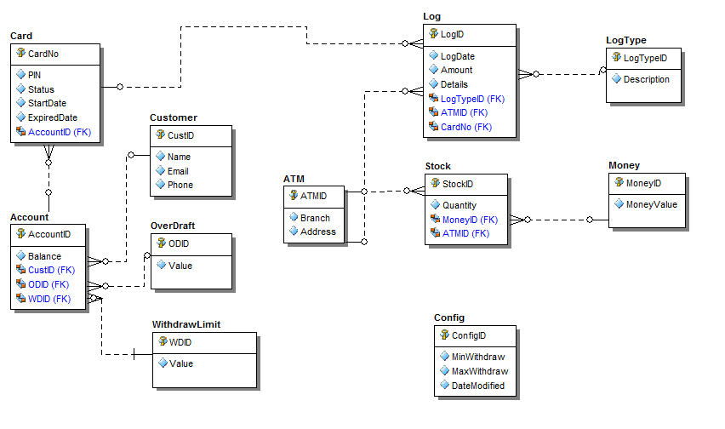
Overview
Entity Relationship diagram

Slide 7
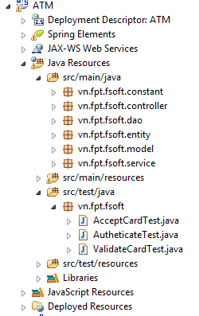
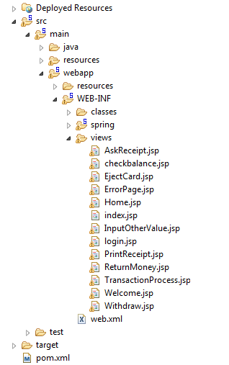
Overview
Project structure

Slide 8
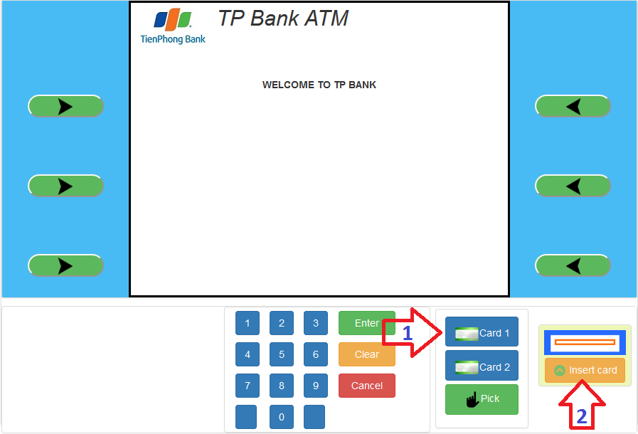
Demo
Demo

Slide 9
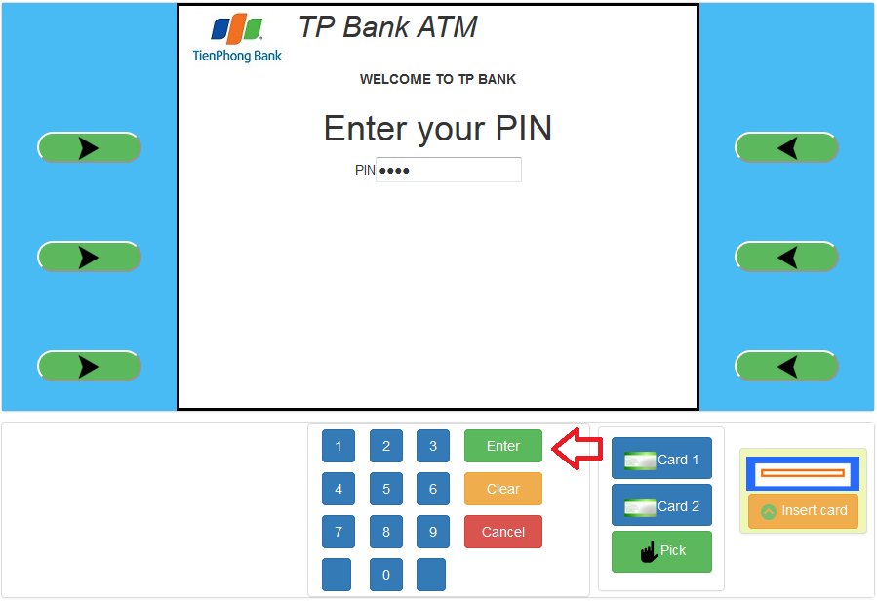
Demo
Demo

Slide 10
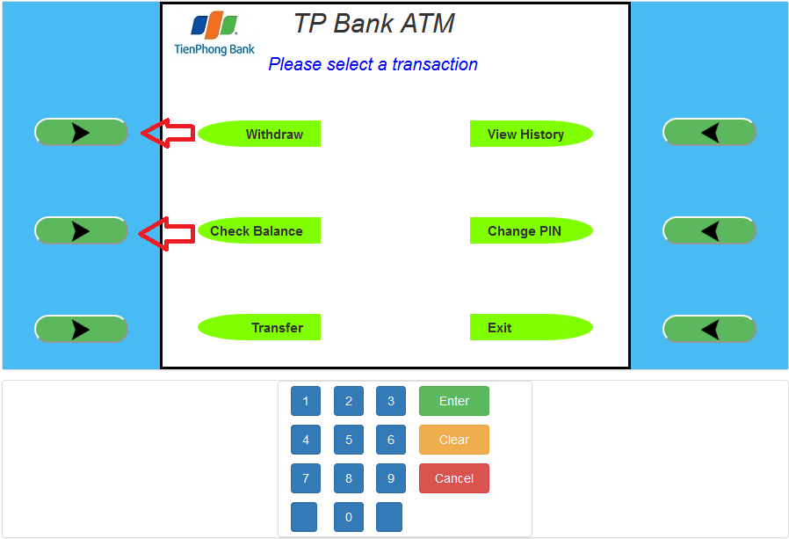
Demo
Demo

Slide 11
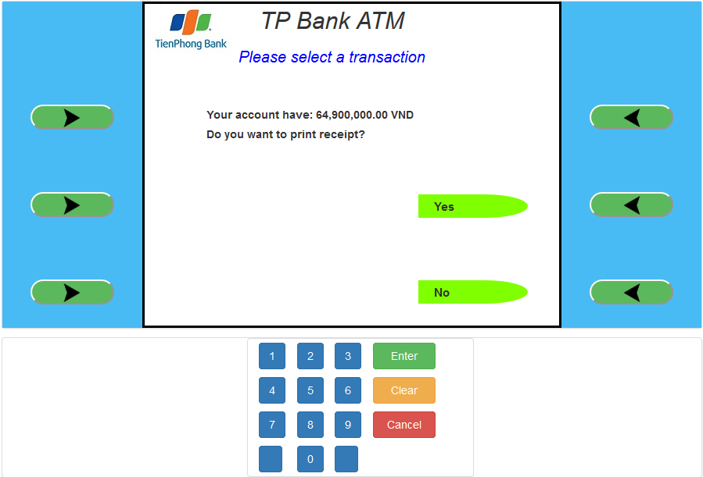
Demo
Demo

Slide 12
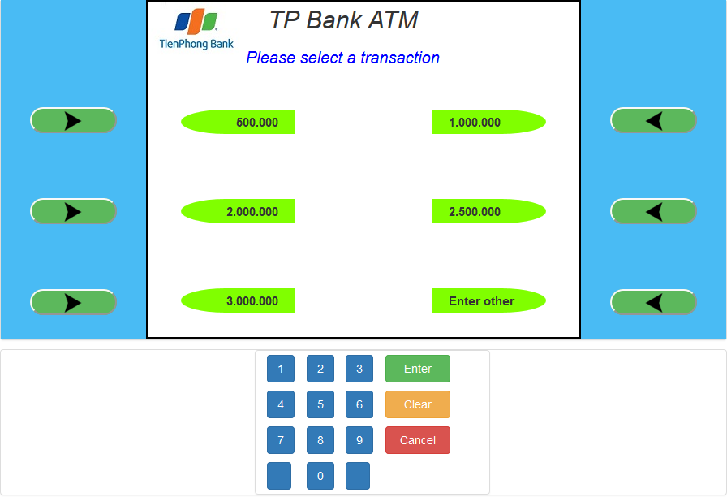
Demo
Demo

Slide 13
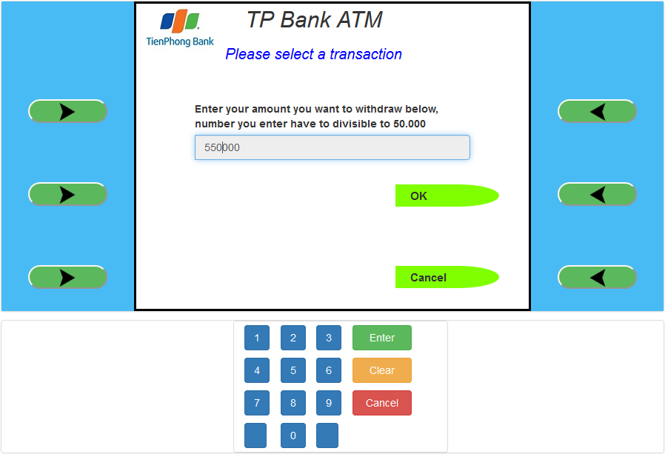
Demo
Demo

Slide 14
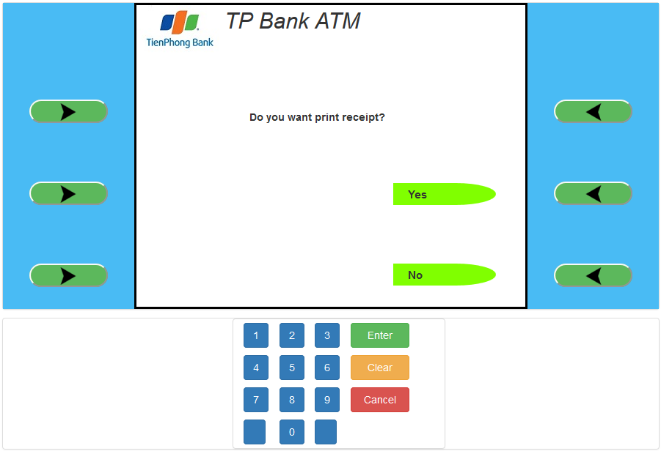
Demo
Demo

Slide 15
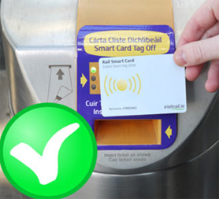

Validation
Validate card
Authenticate user

Slide 16
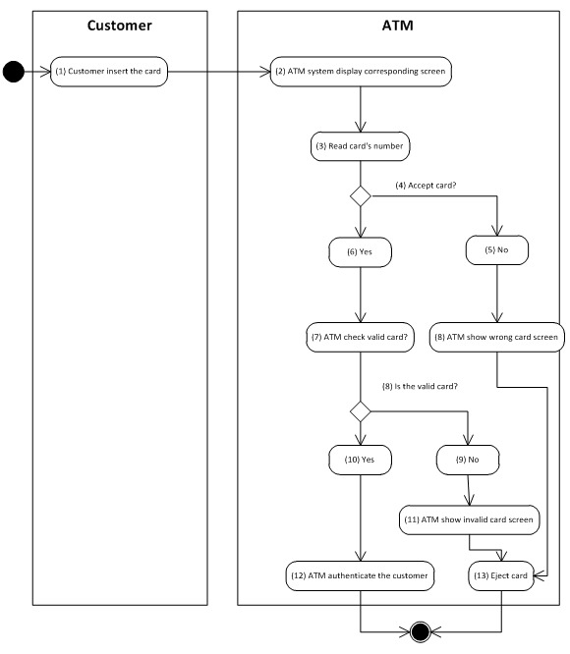
Validation
Validate card
Activity diagram

Slide 17
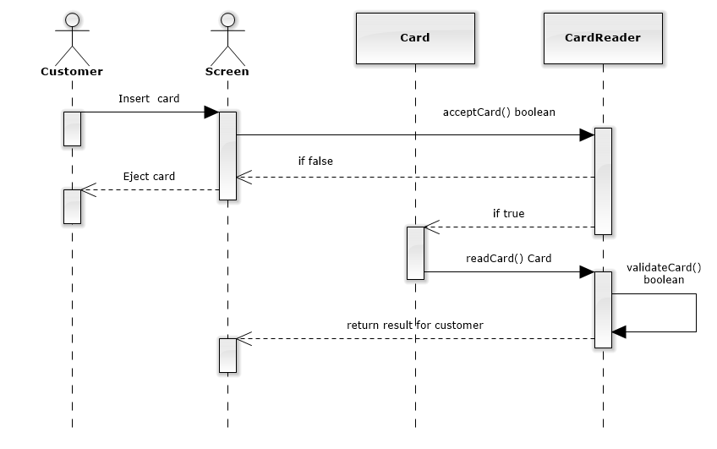
Validation
Validate card
Sequence diagram

Slide 18
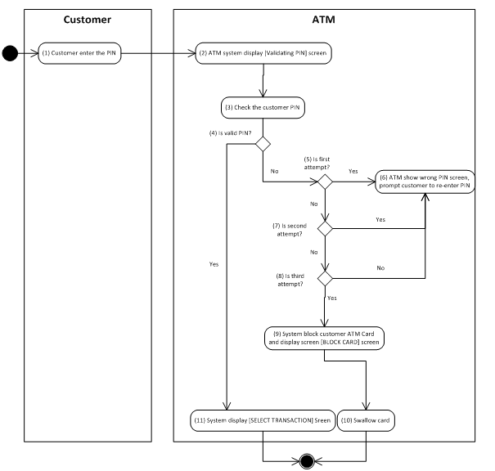
Validation
Authentication
Activity diagram

Slide 19
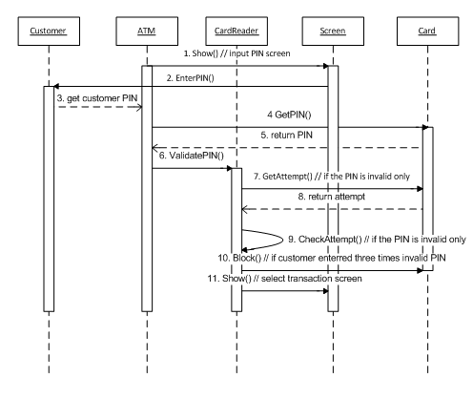
Validation
Authentication
Sequence diagram

Slide 20
Validation
Advantage
Difficult
SRS Document provide very detailed
The help of people with experience
Sociable group and help each other
Problem with bean and session of spring Framework
Query data with Hibernate Framework
Rollback data when run Junit

Slide 21
Check balance
1. Use Case
Name | CheckBalance
Description | This use case allows Customer to check their Balance.
Actor | Customer
Trigger | When Customer click “Check balance” button in MainScreen
Pre-condition | Customer had Validation to ATM.
Post-condition | ATM system display balance of Customer.

Slide 22
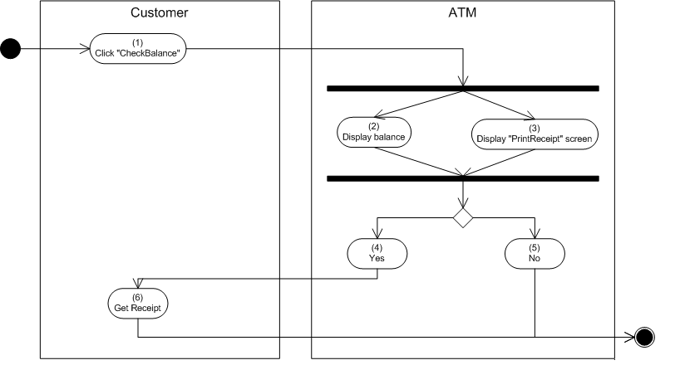
Check balance
2. Activities flow

Slide 23
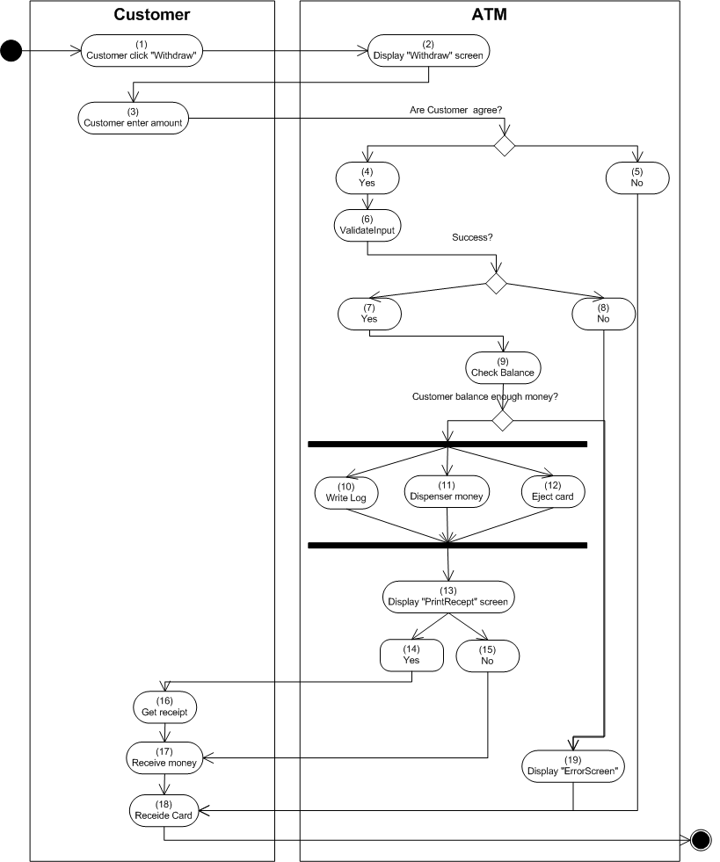
Withdraw
Activity diagram

Slide 24
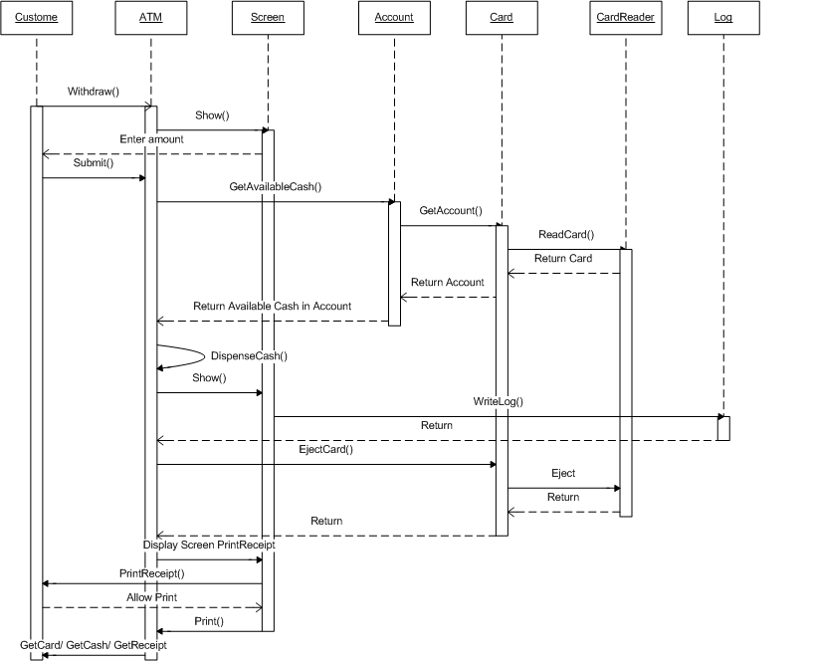
Withdraw
Sequence diagram

Slide 25
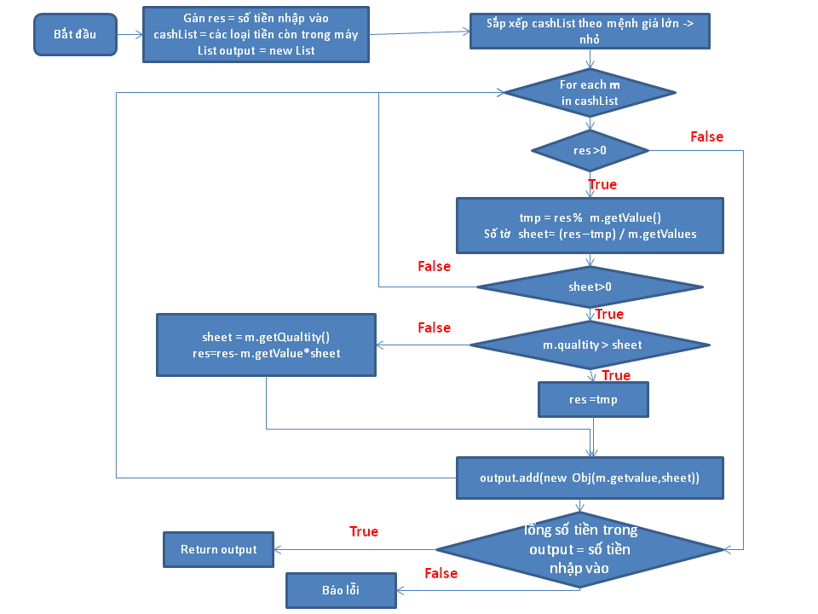
Withdraw
Dispense money

Slide 26
Withdraw
Advantage
Difficult
Sociable group and help each other
Query data with Hibernate Framework
Withdraw function relative to others funtions
SRS not clear

Slide 27
Conclusion
Conclusion
Achieved
Incompleted
Understand software development process
Use Spring MVC, Hibernate in project
Improve teamwork skill, manage code with SVN
Some bugs and exceptions has not fixed
Spring tiles and security has not applied

